Slide 1
Principals of Good Screen Design

Slide 2
Content
Human considerations in screen design
  What screen user want to do
  Interface Design Goals
  Organizing screen elements
  Visually Pleasing composition
  Presenting information Simply and Meaningfully
  Organization and Structure Guidelines

Slide 3
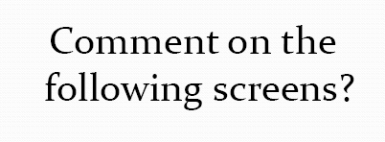

Slide 4
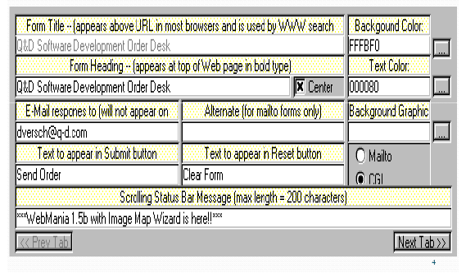

Slide 5
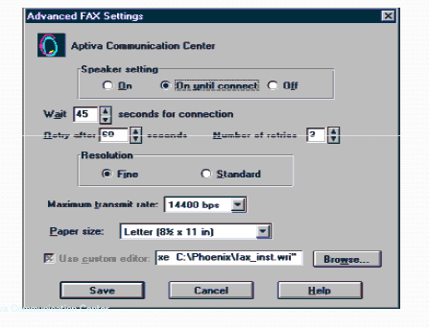

Slide 6
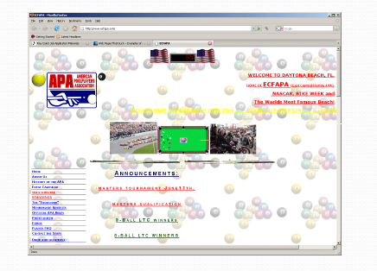

Slide 7
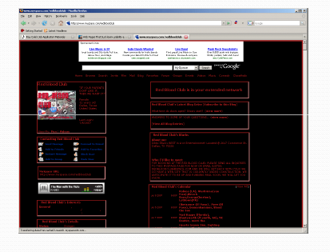

Slide 8
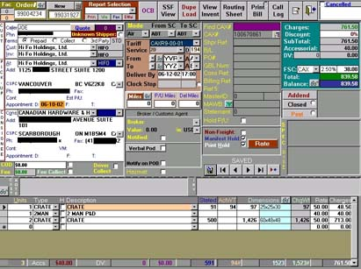

Slide 9
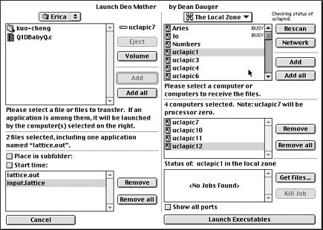

Slide 10
How to Distract screen user??
Common Problems in Visual interface Design
Visual Inconsistency
Lack of restraint in the use of design features and elements
Over-use of three dimensional presentations
Over-use of bright colors
Poorly designed icons
Bad Typography

Slide 11
What Screen Users Want
An orderly, clean, clutter-free appearance
An obvious indication of what is being shown and what should be done with it
Expected information located where it should be
A clear indication of what relates to what, including options, headings, captions, data, and so forth
Plain, simple English
A simple way of finding out what is in a system and how to get it out
A clear indication of when an action can make a permanent change in the data or system

Slide 12
Four Golden Rules
Knowing where you are
  State of system – e.g. Downloading now..
Knowing what you can do
  Which text is clickable
Knowing where you are going
  or what will happen- X-Enter, X-Exit,Icons
Knowing where you’ve been
  or what you’ve done

Slide 13
Interface Design Goals
Reduce visual work
Reduce intellectual work
Reduce memory work
Reduce motor work
Minimize or eliminate any burdens or instructions imposed by technology

Slide 14
Organizing Screen Elements Clearly And Meaningfully
Consistency
Provide real-world consistency
Provide internal consistency, including:
  Operational and navigational procedures
  Visual identity or theme
  Component:
    Organization
    Presentation
    Usage
    Locations
Follow the same conventions and rules across all related interfaces
Deviate only when there is a clear benefit for the user

Slide 15
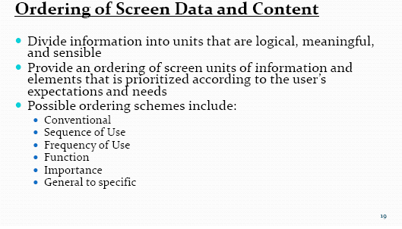
Organizing Screen Elements Clearly And Meaningfully

Slide 16
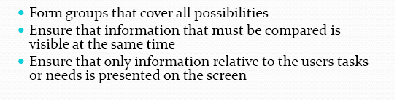
Organizing Screen Elements Clearly And Meaningfully

Slide 17
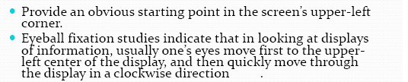

Organizing Screen Elements Clearly And Meaningfully

Slide 18
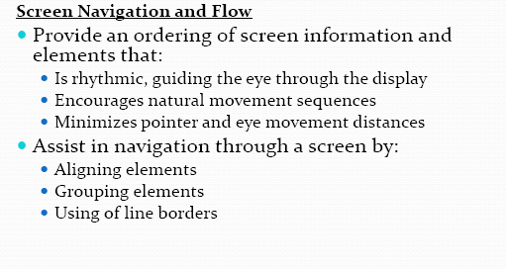
Organizing Screen Elements Clearly And Meaningfully

Slide 19
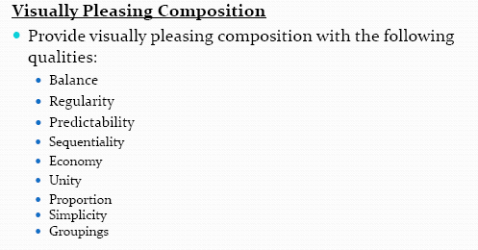
Organizing Screen Elements Clearly And Meaningfully

Slide 20
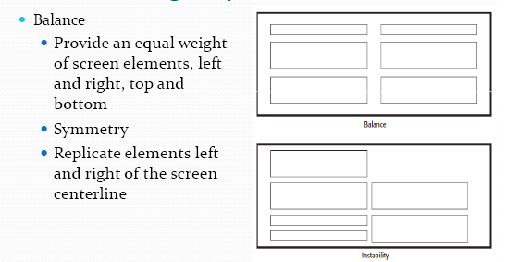
Organizing Screen Elements Clearly And Meaningfully

Slide 21
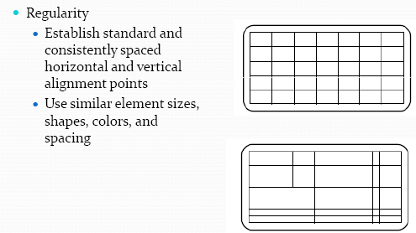
Organizing Screen Elements Clearly And Meaningfully

Slide 22
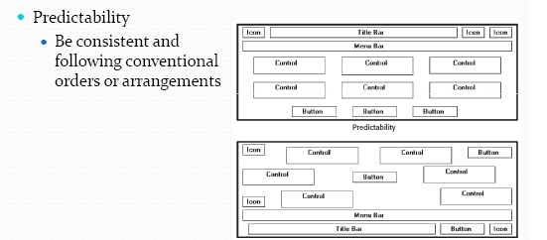
Organizing Screen Elements Clearly And Meaningfully

Slide 23
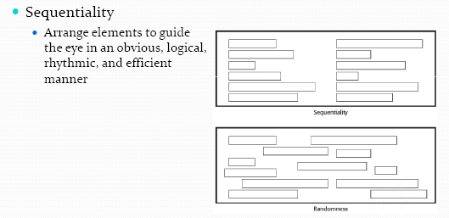
Organizing Screen Elements Clearly And Meaningfully

Slide 24
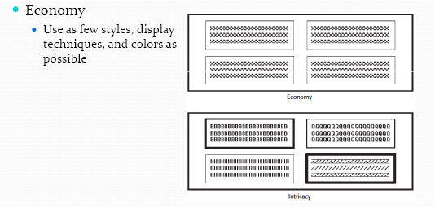
Organizing Screen Elements Clearly And Meaningfully

Slide 25
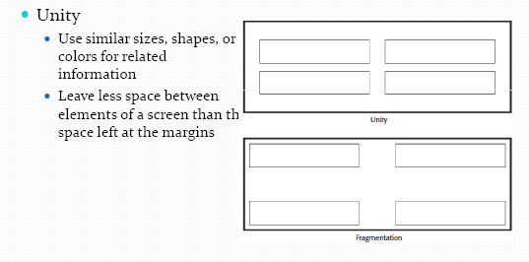
Organizing Screen Elements Clearly And Meaningfully

Slide 26
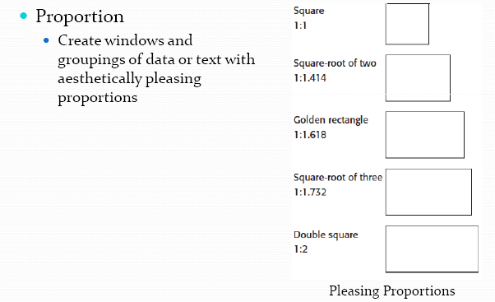
Organizing Screen Elements Clearly And Meaningfully

Slide 27
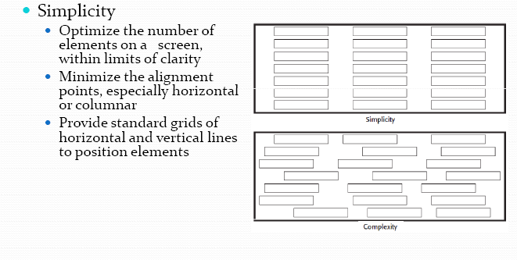
Organizing Screen Elements Clearly And Meaningfully

Slide 28
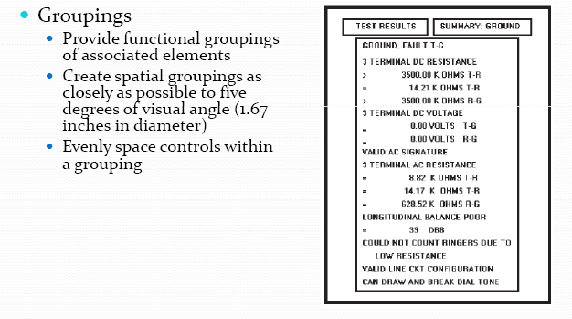
Organizing Screen Elements Clearly And Meaningfully

Slide 29
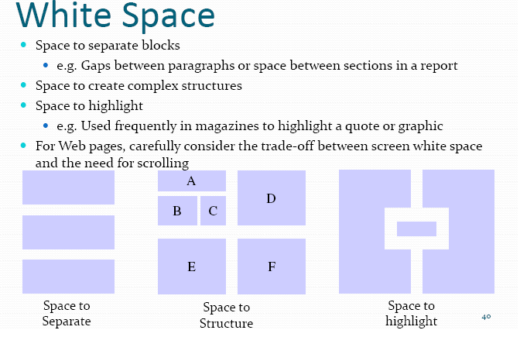

Slide 30
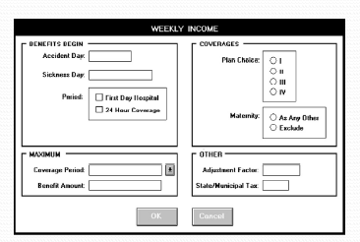
Properly Designed Screen
Alignment of Controls
Grouping – Group Boxes
Right alignment
Of all captions
Capitalized Section Heading
Command buttons centered at bottom

Slide 31
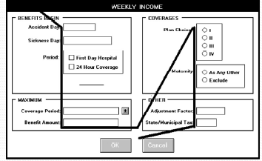
Properly Designed Screen

Slide 32
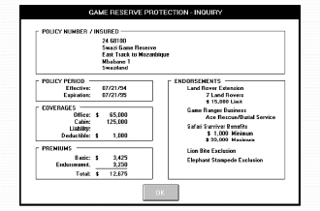
Properly Designed Screen

Slide 33
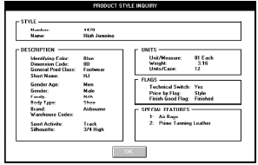
Properly Designed Screen- Read only/Display Only
Good Alignment, Grouping, Balance

